Slide 1

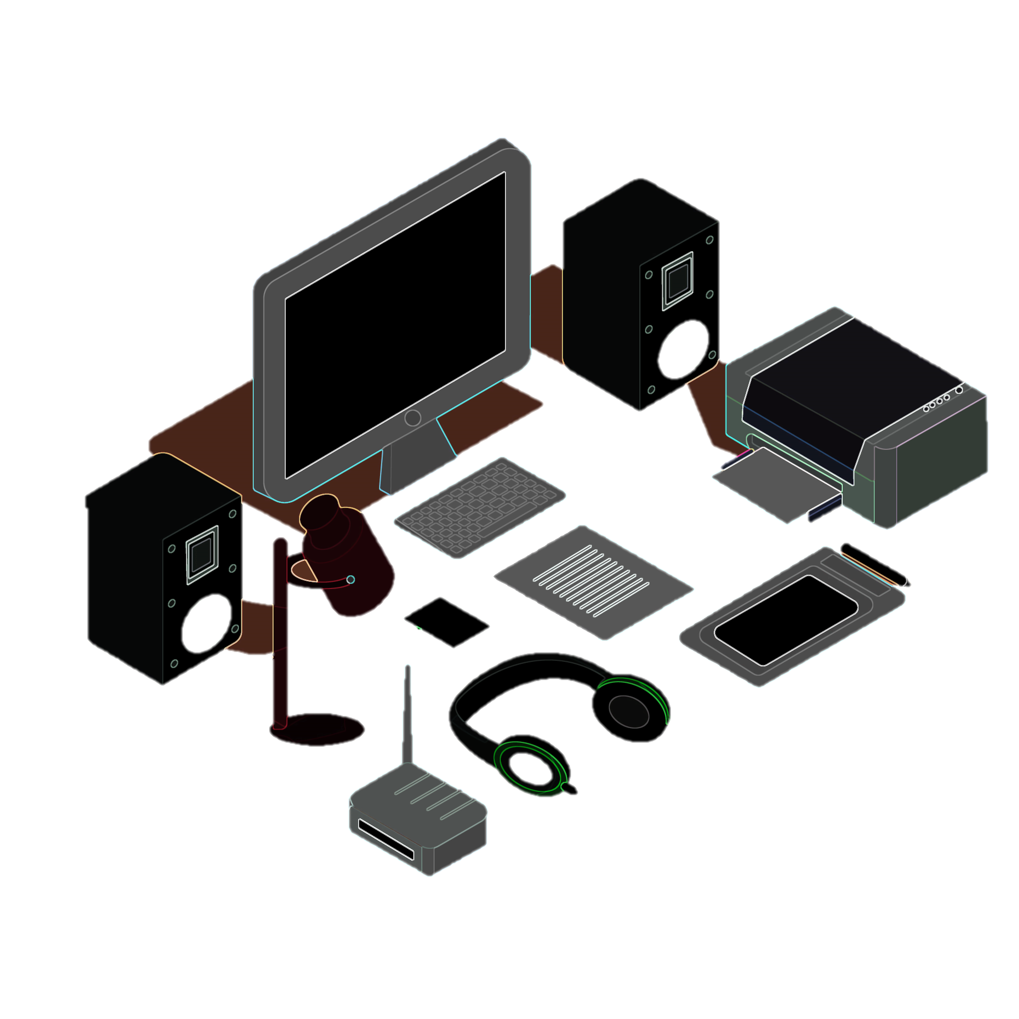
"A CodeBasics Resume Project Challenge - 4 Presentation"
"AtliQ Hardware"
“Providing Insights to the Management in Consumer Goods Domain ”

Slide 2
ABOUT PROJECT :
Company
Atliq Hardware (imaginary company) is one of India’s leading computer hardware producers and
well expanded in other countries.
PROBLEM
The management noticed that they did not get enough insights to make quick and smart data-informed decisions.
They want to expand their data analytics.
Tony Sharma, their data analytics director, wanted to hire someone good at tech and soft skills.
Hence, he decided to conduct an SQL challenge to help him understand both skills.
CHALLENGE
There are 10 ad hoc requests for which the business needs insights. Need to run an SQL query to answer these requests with the help of visualization tools.

Slide 3
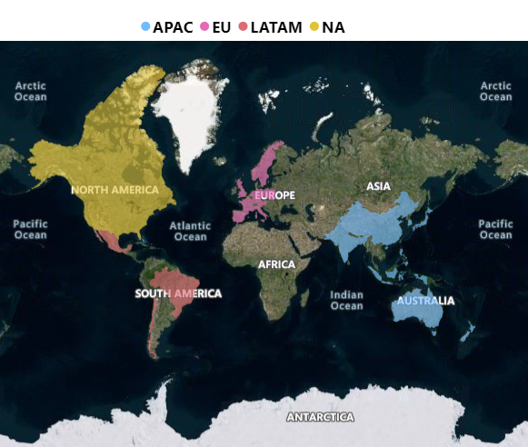
AtliQ’s MARKET

Slide 4
AtliQ’s Product Mapping
PC
DESKTOP
BUSINESS LAPTOP
PERSONAL LAPTOP
NOTEBOOK
BUSINESS LAPTOP
PERSONAL LAPTOP
GAMING LAPTOP
P&A
PERIPHERALS
GRAPHIC CARD
INTERNAL HDD
ACCESSORIES
BATTRIES
KEYBOARD
MOUSE
MOTHERBOARD
PROCESSORS
N&S
NETWORKING
WIFI EXTENDER
EXTERNAL SSD
STORAGE
USB FLASH DRIVES

Slide 5
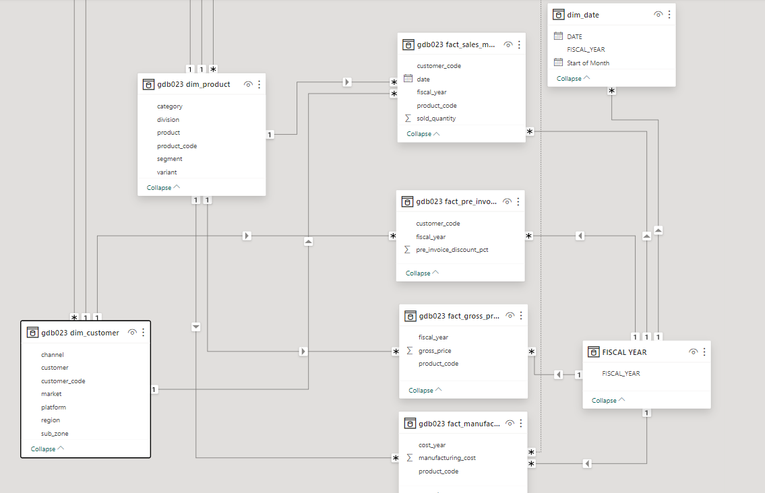
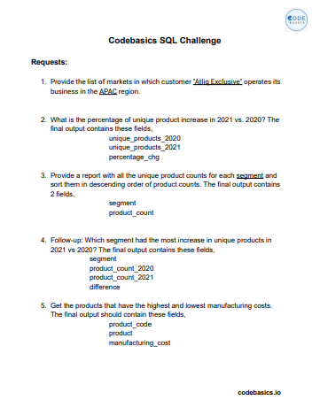
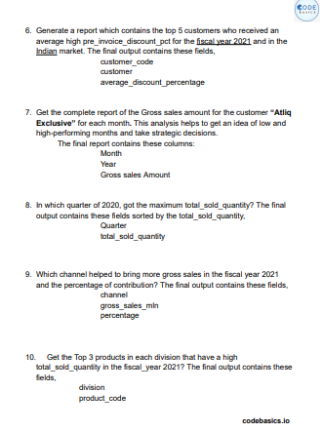


INPUT DATA
AD-HOC QUESTIONS
TOOLS USED

Slide 6
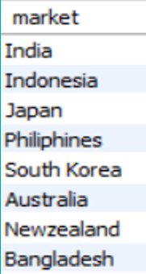
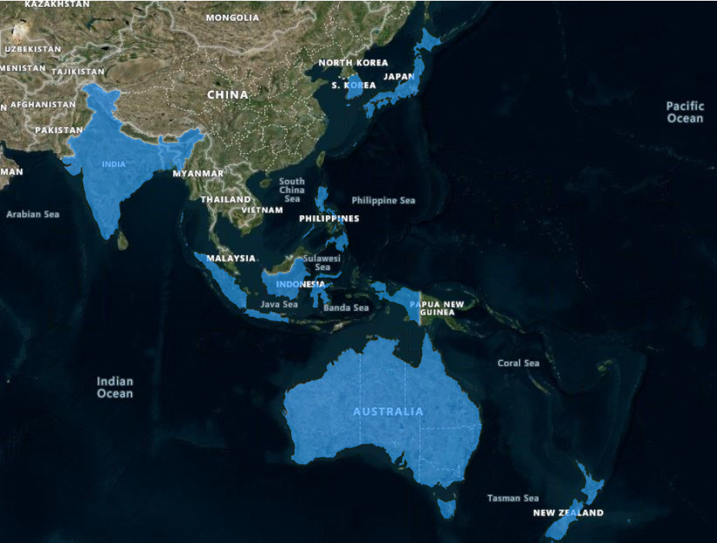
QUESTION 1
Provide the list of markets in which customer "Atliq Exclusive" operates its business in the APAC region.
INSIGHTS
AtliQ Exclusive operates its business in 8 Markets in APAC REGION
Top 2 Markets are INDIA AND AUSTRALIA IN TERMS OF SIZE.

Slide 7

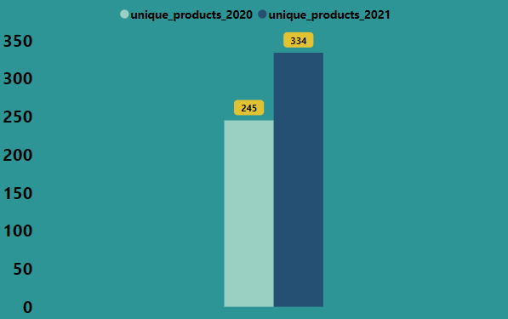
QUESTION 2
What is the percentage of unique product increase in 2021 vs. 2020?
36.33 % CHANGE
2020
2021
INSIGHTS
There is 36.33 % change in No.of Unique Products between 2020 -2021.
89 more products were introduced in the year 2021

Slide 8
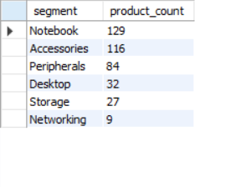
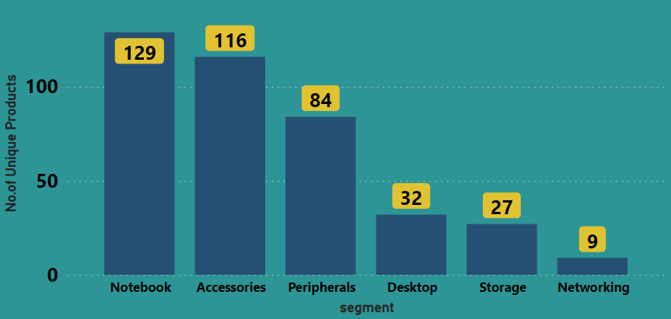
QUESTION 3
Provide a report with all the unique product counts for each segment and sort them in descending order of product counts?
INSIGHTS
The "Notebook“ & “ Accessories” segment shows the highest product count, indicating strong market demand.
The "Networking“, “Desktop”, and “Storage” segment has a relatively lower product count. Atliq Hardware should explore opportunities to diversify or expand its offerings in these specific segments to meet potential market demand.

Slide 9
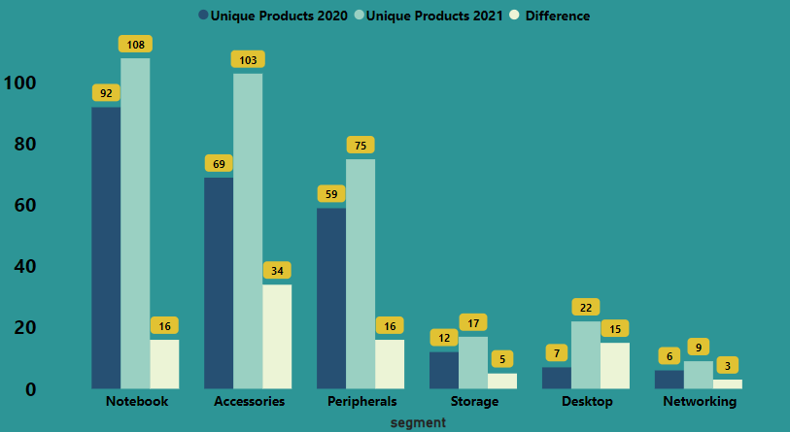
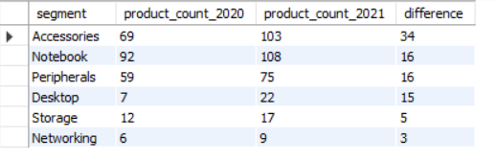
QUESTION 4
Which segment had the most increase in unique products in 2021 vs 2020?
INSIGHTS
Atliq introduced 34 New unique Products in the Accessories segment in the year 2021 showing significant demand in the market for accessories.
The "Networking“,” Desktop”, and” Storage” segment has a lower product count, a modest increase indicates a growing market. Assess opportunities to enhance offerings in these specific segment products.

Slide 10
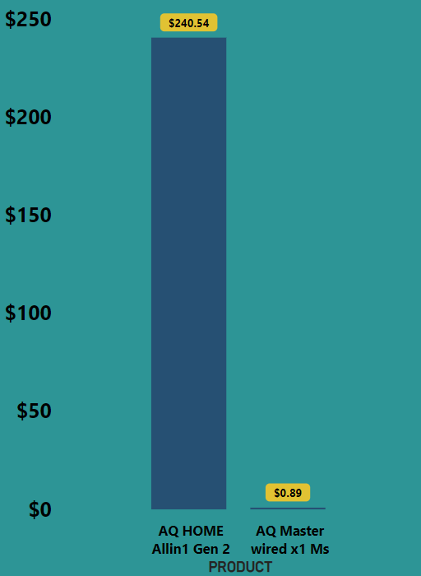

QUESTION 5
Get the products that have the highest and lowest manufacturing costs.
PERSONAL DESKTOP
INSIGHTS
"AQ HOME Allin1 Gen 2" commands a higher price, suggesting it may be a premium or feature-rich product.
Atliq Hardware's ability to offer products with varying features and price points to meet diverse customer preferences.
MOUSE

Slide 11
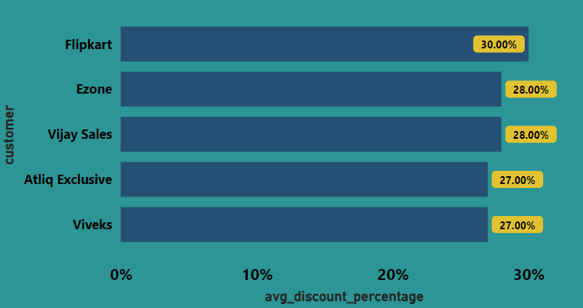
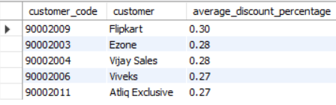
QUESTION 6
Generate a report which contains the top 5 customers who received an average high pre_invoice_discount_pct for the fiscal year 2021 and in the Indian market.
INSIGHTS
Flipkart got the highest % of pre-invoice discount.
The difference in discounts w.r.t top 5 are within 2 to 3 % .

Slide 12
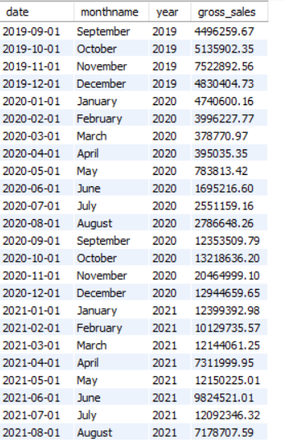
QUESTION 7
Get the complete report of the Gross sales amount for the customer “Atliq Exclusive” for each month. This analysis helps to get an idea of low and high-performing months and take strategic decisions.
INSIGHTS
Atliq Hardware experiences significant seasonality, with notable peaks during November 2019 and 2020. Understanding these seasonal patterns is critical for inventory planning, marketing, and resource allocation.
The sales drop in March 2020 indicates the initial impact of external factors such as the global pandemic but after that, we showed slow growth month by month.
The significant dip in sales in August 2021 warrants investigation. Understanding the reasons behind this drop, whether seasonal, market-related, or other external factors, is crucial for developing corrective strategies and ensuring future stability.

Slide 13
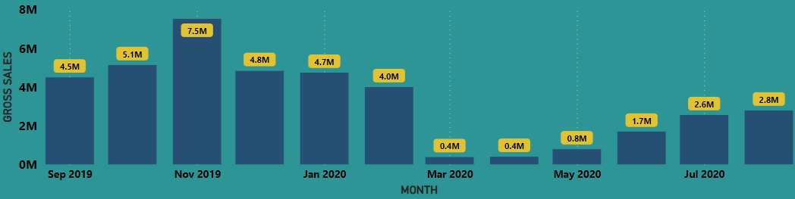
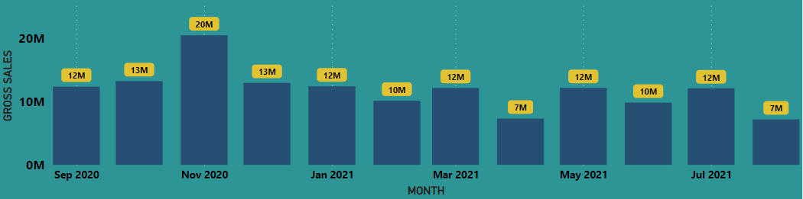
FISCAL YEAR 2020
FISCAL YEAR 2021

Slide 14
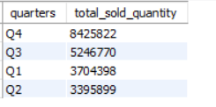
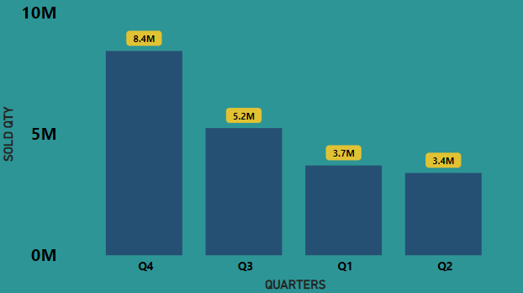
QUESTION 8
In which quarter of 2020, got the maximum total_sold_quantity?
YEAR 2020
INSIGHTS
Atliq Hardware's sales are highest in Q4, indicating a peak in demand during the last quarter of the year. Understanding this seasonality is crucial for effective inventory management, marketing, and resource allocation.
Q2 has a comparatively lower total sold quantity. Exploring opportunities to boost sales during this period, such as targeted promotions or new product launches, can contribute to a more balanced sales distribution across quarters

Slide 15
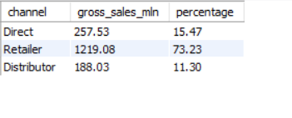
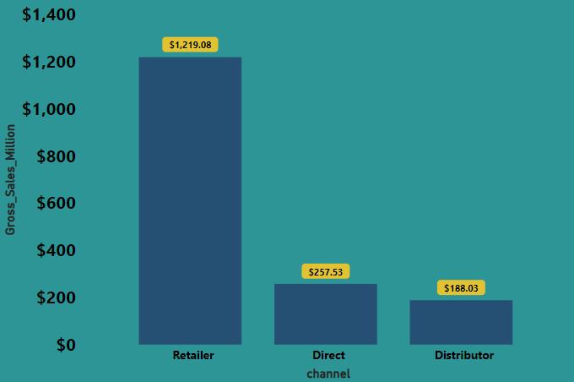
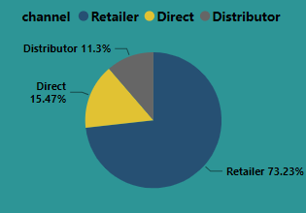
QUESTION 9
Which channel helped to bring more gross sales in the fiscal year 2021 and the percentage of contribution?
FISCAL YEAR 2021
PERCENTAGE CONTRIBUTION
INSIGHTS
Retailer channels contribute significantly to Atliq Hardware's gross sales, constituting 73.23% of the total.
Strengthening relationships with retailers, optimizing inventory, and implementing targeted marketing strategies can further
enhance this channel's performance.
Explore strategies to enhance the 15.47% contribution from direct sales and the 11.3% contribution from distributor channels. This involves refining direct sales approaches for increased customer engagement and expanding distributor partnerships for broader market reach.

Slide 16
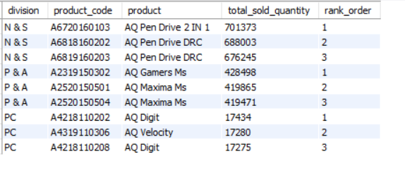
QUESTION 10
Get the Top 3 products in each division that have a high total_sold_quantity in the fiscal_year 2021?

Slide 17
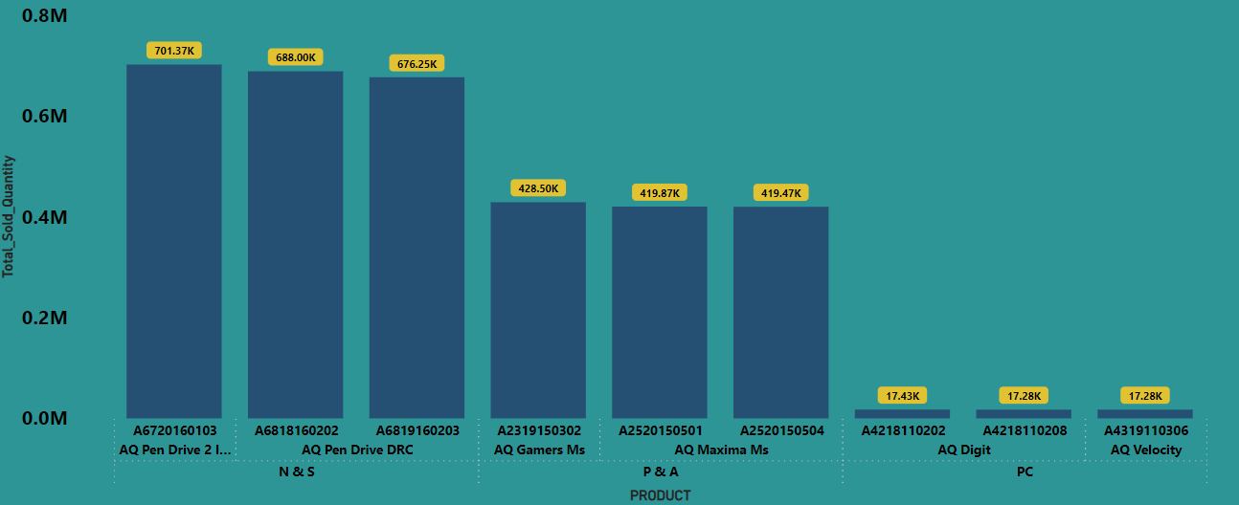
FISCAL YEAR 2021
INSIGHTS
In the "N & S" division, "AQ Pen Drive 2 IN 1" leads in total sold quantity, showcasing strong demand.
In "P & A," "AQ Gamers Ms" takes the top spot, while in the "PC" division, "AQ Digit" stands out.
The presence of "AQ Gamers Ms" in the top spot for the "P & A" division indicates a potential market demand for gaming-related products. Exploring this trend further and expanding the gaming product line may align with consumer preferences.

